Slide 1
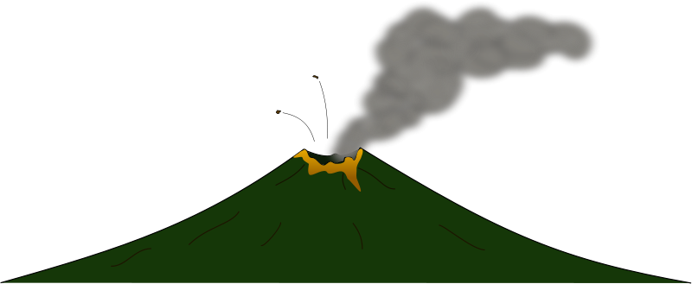
Volcanoes
What do you know already about volcanoes?
GO

Slide 2
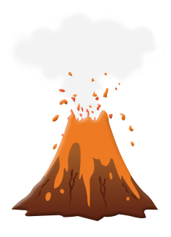
Let’s learn more. Click on the links below.
What is a volcano?
What is magma and what is lava?
What types of volcano are there?
What causes a volcano to erupt?
Famous volcanoes and eruptions across the world

Slide 3
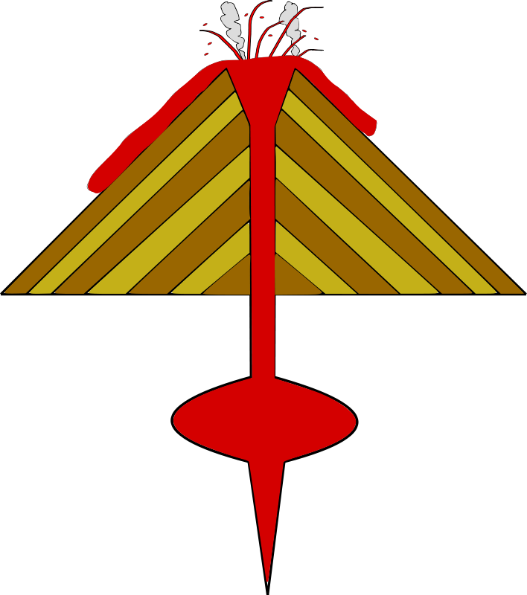

What is a volcano?
A volcano is a mountain that opens downward to a pool of molten rock called magma, below the surface of the earth.
When pressure builds up, eruptions occur.
Gases and rock shoot up through the opening and spill over or fill the air with lava fragments.

Slide 4
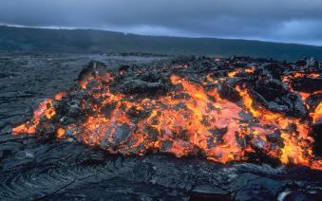
What is magma and what is lava?
Magma is liquid rock within a volcano
Lava is magma that flows out of a volcano.
Lava
Magma

Slide 5
What types of volcano are there?
We can group volcanoes into three main types.
Click to find out more about each one:
Active
Dormant
Extinct

Slide 7
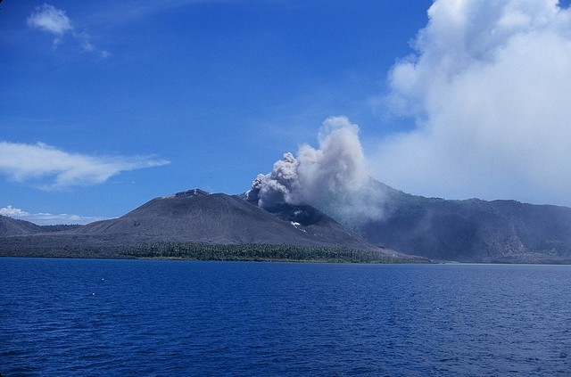

What types of volcano are there?
We can group volcanoes into three main types.
Click to find out more about each one:
These are volcanoes that scientists think are likely to erupt soon.
They often have little earthquakes near them and gas coming out.
Active
Dormant
Extinct
An active volcano in Papua New Guinea.

Slide 9
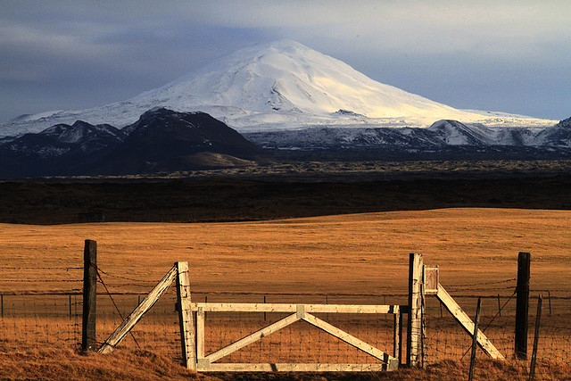
What types of volcano are there?
We can group volcanoes into three main types.
Click to find out more about each one:
These are volcanoes that scientists think might erupt again in the future.
They have magma deep underneath them, but can look quite calm on the outside.
Active
Dormant
Extinct
A dormant volcano in Iceland called Helka.

Slide 11
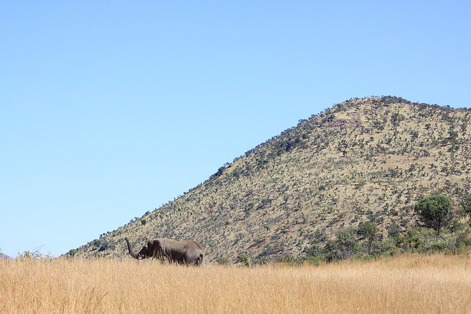
What types of volcano are there?
We can group volcanoes into three main types.
Click to find out more about each one:
These are volcanoes that scientists think will never erupt again.
They often look like normal hills or mountains, and have no magma inside.
Active
Dormant
Extinct
An extinct volcano in South Africa.

Slide 12

What causes a volcano to erupt?
First we need to understand that the earth is made up of 3 layers. These are the crust, mantle and core.
Click on the labels to find out more about them:
The Crust
The Mantle
The Outer core
The Inner core

Slide 13
The Crust
This is the top or outer later of the Earth that we live on.
It is about 18 miles thick.
The Crust
The Mantle
The Outer core
The Inner core

Slide 14
The Mantle
The second layer is called the mantle. It is about 1,800 miles thick and is mostly made up of super heated rock.
The Crust
The Mantle
The Outer core
The Inner core

Slide 15
The Core
The inner layer is called the core. It consists of super heated lava, mostly melted iron and nickel.
The Crust
The Mantle
The Outer core
The Inner core

Slide 17

What causes a volcano to erupt?
The Earth's crust is made up of huge slabs called plates, which fit together like a jigsaw puzzle. These plates sometimes move.
Between the Earth's crust and the mantle is a substance called magma which is made of rock and gases.

Slide 18
What causes a volcano to erupt?
When two plates collide, one section slides on top of the other, the one beneath is pushed down. Magma is squeezed up between two plates. This can cause volcanoes to erupt.
A volcano erupts when magma and gases find a way to escape, so they burst to the surface through a vent. An eruption can be quite gentle or very violent.

Slide 19
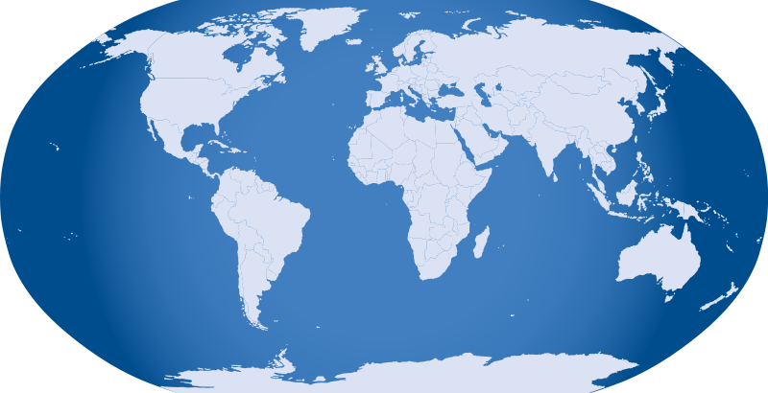




Famous volcanoes and eruptions across the world
Click on the map for more information

Slide 20
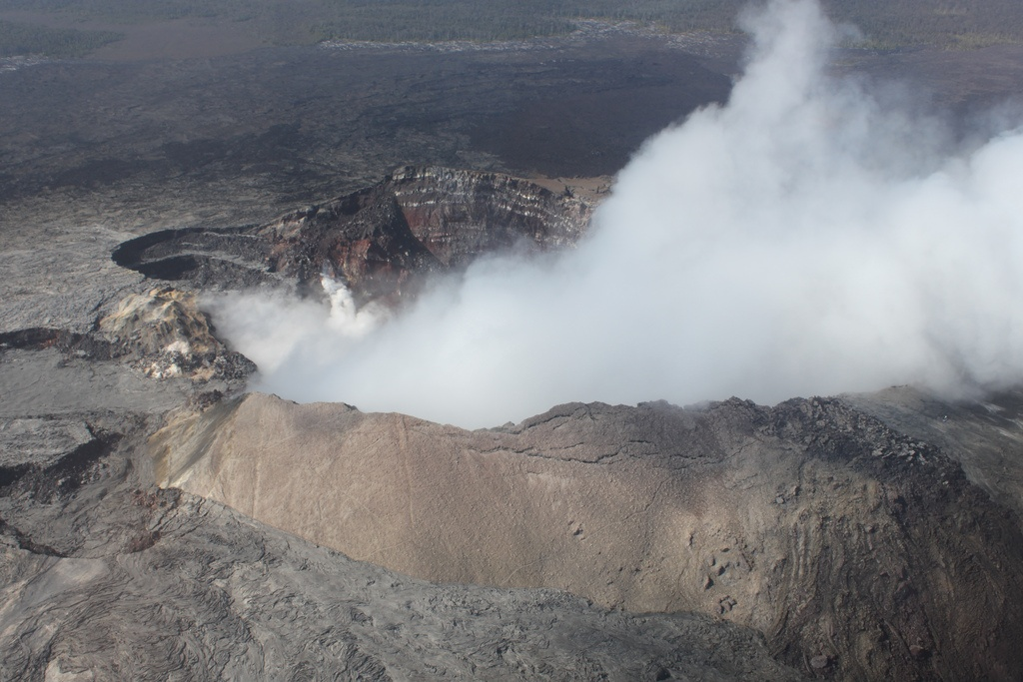
Mauna Loa, Hawaii
GO

Slide 21

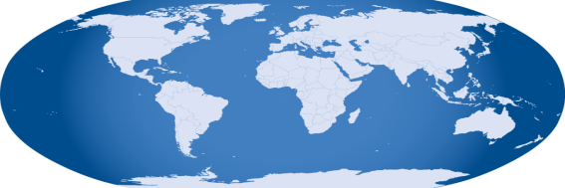
Mauna Loa, Hawaii
Mauna Loa in Hawaii is the biggest volcano in the world right now.
Most of the volcano is hidden beneath the sea. It is actually taller than Mt Everest if you measure it from the ocean floor.
Back to Map

Slide 22
Krakatoa and Mount Tambora
Krakatoa erupted in 1883.
When Krakatoa erupted, 35,000 people died. This was mostly because of the huge tidal waves that were caused by the eruption.
The Tsunamis caused by the earthquake reached to nearly 40 metres.
Mount Tambora erupted in 1815.
This volcano killed the most people that we know of. 92,000 people died.
So much ash was sent into the atmosphere that the world’s climate was cooled for a whole year. Some people called it ‘The year without summer’.
Back to Map

Slide 23
Novarupta, Alaska
Novarupta erupted in 1912.
It was the largest eruption of the twentieth century.
There was so much dust that people at a nearby town could not see a lamp held at arm’s length for 2 days.
The eruption caused acid rain. It was reported that clothes on a clothes line disintegrated in Vancouver, Canada – that’s over 2300km away!
Back to Map

Slide 24
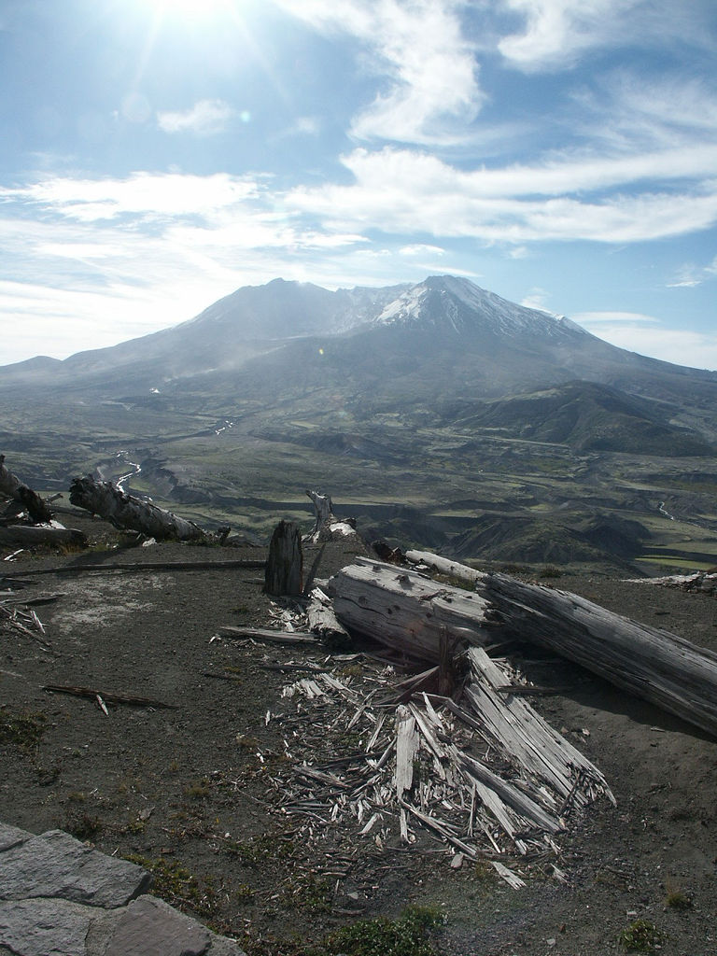
Mount St. Helens, USA
Mount St. Helens last erupted in 1980.
The noise of the explosion from the eruption was heard as far away as California.
Back to Map

Slide 25
Topic Vocabulary
Crust
The top layer of the Earth.
Melted liquid.
Molten
Crater
Vent
A deep hollow at the top of a volcano.
A crack on the side of a volcano where magma can escape.
Eruption
The release of gases, magma and rock from a volcano.
Active: Volcanoes that are likely to erupt soon.
Types of Volcano:
Dormant: Volcanoes that may erupt in the future.
Lava
Melted rock that flows down the volcano.
Extinct: Volcanoes that will not erupt again.
Magma
Melted rock inside the Earth.

