Slide 1
Water Facts
Figures are taken from water aid website.

Slide 2
How much water do you
think we use a day
A Between 5-6 litres
B Between 40 – 50 litres
C Between 135 –140 litres a day
ANSWER! BETWEEN 135-150 LITRES A DAY!

Slide 3
Filling a kettle
Filling a kettle can use 2.5 litres of water. Try and use the minimum amount of water you need.

Slide 4
Filling a bath
A bath can use 80 litres of water – twice as much as is needed for a five minute shower.

Slide 5
Washing machine
The washing machine uses 65 litres of water. A half load programme uses more than half the water of a full load. Wait and run a full load.

Slide 6
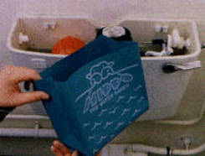
Flushing the toilet
A toilet can use up to ten litres of water if it is old. Putting a hippo in the cistern can save an average of 2.5 litres every flush.
*other products are available. ☺

Slide 7
Leave a tap running
Up to five large bottles of water can be used if you leave the tap running when you brush your teeth.

Slide 8
A dripping tap
A tap dripping once per second can waste four litres of water a day.

Slide 9
Hosepipies
If you water your garden with a hosepipe then you can use 540 litres of water an HOUR. If you fill your watering can up with rain water then no water is wasted.

