Slide 1
VII. Water Treatment
A. Treatment of wastewater and
B. Treatment of drinking water

Slide 2
Objectives - students should:
List and describe treatment methods for wastewater.
List and describe treatment methods for drinking water.
Compare and contrast treatment methods and goals of wastewater and drinking water.

Slide 3
Justification for wastewater treatment:
Pollution from sewage is a primary environmental health hazard (wastewater effluent).
The purpose of municipal wastewater treatment is to limit pollution of the receiving watercourse.
The receiving watercourse may also be a source of drinking water.

Slide 4
Goals of wastewater treatment:
Reduction of organic load of the wastewater effluent to limit eutrophication (BOD, COD limits),
Reduction of microbiological contamination that may transmit infectious disease.

Slide 5
Municipal wastewater treatment facility and regulations
Municipal wastewater treatment facilities, or “Publicly Owned Treatment Works” (POTWs), or “Water Reclamation Districts” are designed to reduce environmental health risks of untreated wastewater.
Levels of treatment required are based on NPDES regulations.

Slide 6
Wastewater Treatment Scheme
Disinfectant
WW effluent
WW
influent
Preliminary
Secondary
Primary
Tertiary
sludge
Sludge Treatment
and Disposal

Slide 7
Wastewater treatment processes:
Preliminary treatment is a physical process that removes large contaminants.
Primary treatment involves physical sedimentation of particulates.
Secondary treatment involves physical and biological treatment to reduce organic load of wastewater.
Tertiary or advanced treatments.

Slide 8
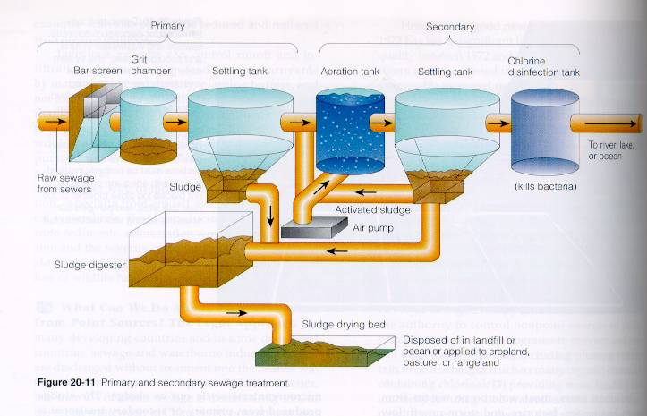

Slide 9
Tertiary or Advanced Treatment
Nitrification-denitrification process to remove N and P
Filtration
Carbon Adsorption
Constructed (Man-made] Wetland

Slide 10
On-site wastewater treatment
More than 25% of all households in the U.S. are served by on-site treatment systems.
About 3 billion gallons of wastewater is discharged each day to on-site wastewater treatment systems.
Potential disease transmission risks through wastewater should be limited.

Slide 11
Typical septic system design:
Septic systems typically consist of:
✰ A septic tank (concrete, with inlet and outlet, baffles, and removable top for cleaning), which collects and holds waste,
• A drain field or tile field (plastic or tile pipe with outlets) which allows wastewater effluent to infiltrate slowly into soils.
 Plumbing connections.

Slide 12
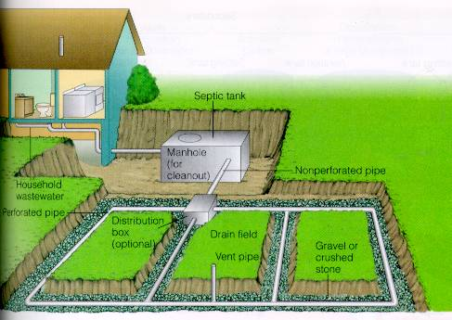

Slide 13
Periodic summery
Treatment of wastewater is necessary to protect the environment and preserve the quality of water for drinking.
Treatment of municipal wastewater typically includes preliminary, primary treatment, secondary treatment, and tertiary treatment.
On-site wastewater treatment is facilitated by septic tank systems.

Slide 14
B. Drinking water treatment:
Clarification - primarily a physical process, but may be aided by addition of chemicals.
Filtration - also primarily physical, but chemicals may aid the process.
Disinfection - typically a chemical process that reduces pathogenic microorganisms.

Slide 15
B1. Clarification of drinking water:
Clarification removes particulates that contribute to turbidity and contamination of water.
Clarification is aided by chemicals which cause particulates to aggregate, precipitate, and form sediment (sludge).

Slide 16
B2. Filtration:
Separate nonsettleable solids from water.
Combined with coagulation/clarification, filtration can remove 84%-96% turbidity, coliform bacteria 97-99.95%, and >99% Giardia.

Slide 17
Type of Filtration
Rapid filtration - uses gravity (faster flow).
Slow filtration - uses gravity [slower flow].
Pressure sand filters-use water pressure.
Diatomaceous earth (DE) filtration
Microstraining - uses fine steel fabric (sometimes used prior to other filtrations).

Slide 18
Filter Media
Filter media should be:
coarse enough to retain large quantities of floc
sufficiently fine to prevent passage of suspended solids
deep enough to allow relative long filter runs
Granular-medium filters (Rapid Sand Filters]
Anthracite on the very top (least dense),
fine sand on top of supporting coarse sand(less dense), which lays on top of
gravel layer (highest density).

Slide 19
Cleaning (backwashing) filters
Determination of how often to back-wash can be made on the basis of:
Head loss (pressure loss),
Loss of water quality (e.g., increased turbidity), or
Time since last backwash.

Slide 20
Backwashing process
Water flow is reversed through the filter bed.
The rate of backwash is designed to partially expand (fluidize) the filter bed.
Suspended matter is removed by shear forces as the water moves through the fluidized bed.
Additional cleaning occurs when particles of the bed abrade against each other.

Slide 21
Flow control through filters
Constant-rate filtration
Flow rate is controlled by limiting the discharge rate, limiting the rate of inflow by a weir, or
by pumping or use of influent flow-splitting weir.
Declining-rate filtration
Rate of flow declines as the rate of head loss builds (influent- or effluent-controlled).

Slide 22
Periodic Summary:
Drinking water treatment typically include clarification, filtration and disinfection.
Drinking water treatment should make water both potable and palatable.
Wastewater and drinking water treatment processes are similar in several ways.

Slide 23
VII. Water Treatment
B3. Disinfection of drinking water

Slide 24
Objectives - students should:
Define and give examples of types of disinfection techniques for drinking water.
Distinguish between physical and chemical disinfection techniques.
Evaluate the safety, cost, effectiveness, and popularity of various disinfection techniques.

Slide 25
Types of disinfection:
Physical disinfection techniques include boiling and irradiation with ultraviolet light.
Chemical disinfection techniques include adding chlorine, bromine, iodine, and ozone to water.

Slide 26
Physical disinfection (boiling):
Boiling kills vegetative bacterial cells, but spores, viruses, and some protozoa may survive long periods of boiling.
Boiling may also volatilize VOC’s.
Boiling is an effective method for small batches of water during water emergencies.
Boiling is prohibitively expensive for large quantities of water.

Slide 27
Physical disinfection (UV radiation):
Ultraviolet radiation is an effective and relatively safe disinfection method, but is relatively expensive and not widely used.
UV light disrupts DNA of microbial cells, preventing reproduction.
Specific wavelengths, intensities, distances, flow rates, and retention times are required.

Slide 28
Chemical disinfection:
Chemicals added to water for disinfection include chlorine, bromine, and iodine.
Bromine is not recommended for drinking water disinfection, but may be used for pool water.
Iodine is sometimes used for drinking water disinfection, but causes a bad aftertaste.

Slide 29
Chlorine disinfection:
Chlorination is a cheap, effective, relatively harmless (and therefore most popular) disinfection method.
Chlorine is added as a gas or hypochlorite solution.
Hypochlorous acid and hypochlorite ions form in solution, which are strong chemical oxidants, and kill microbes.

Slide 30
Chlorine disinfection (cont.):
Combined chlorine is the proportion that combines with organic matter.
Free chlorine is the amount that remains to kill microbes in the distribution system (0.5 ppm, 10 min.)
Total chlorine is the combined concen-tration of combined and free chlorine.

Slide 31
Disinfection By-Products (DBPs)
Chlorine (or bromine or iodine) + “precursors” (organic compounds) = THM(Trihalomethanes)
eg. Chloroform (CHCl₃), Bromoform (CHBr₃), Iodoform (CHI₃), chlorobromoform (CHBrCl₂), Bromochloroform (CHBr₂Cl), Bromoidodform (CHBr₂I), etc.
THMs are carcinogenic
Choroamine disinfection reduce THMs production due to preferential reaction of chlorine with ammonia

Slide 32
Ozonation:
Ozone (O₃) is an effective, relatively harmless disinfection method, but is expensive (and therefore less popular than chlorine).
Ozone is a strong oxidant, that produces hydroxyl free radicals that react with organic and inorganic molecules in water to kill microbes.

Slide 33
Summary:
Disinfection is the destruction of microorganisms in drinking water to safe levels.
Disinfection techniques include physical (boiling, ultraviolet light) and chemical methods (chlorine, bromine, iodine, and ozone).

