Slide 1


Wet or Dry?

Slide 2
Would you wear these clothes when it is wet or dry?

Slide 3
wet

Slide 4
dry

Slide 5
wet

Slide 6
dry

Slide 7
wet

Slide 8
dry

Slide 9
dry

Slide 10
dry

Slide 11
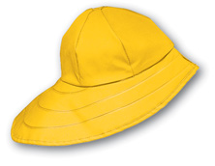
wet

