Slide 1
Which pictures are plants?
Write the numbers of the plant pictures on your whiteboard.
Notes:
Here is a PowerPoint I made for my year 3 class related to our Plants topic. I asked children to record the numbers of the photos they thought were plants on their whiteboards and we then counted (at the end) how many children thought each of the photos were of a plant. I then revealed to them that they were all plants.

Slide 2
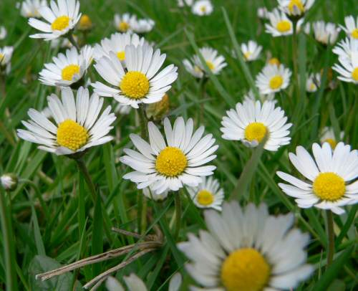
Daisy

Slide 3
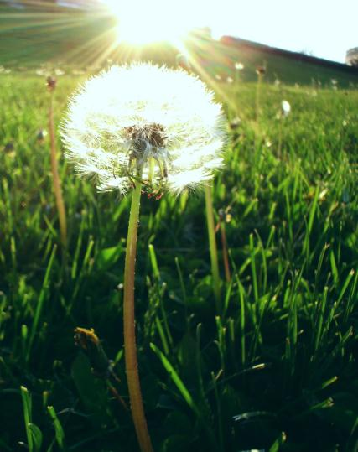
Dandelion

Slide 4
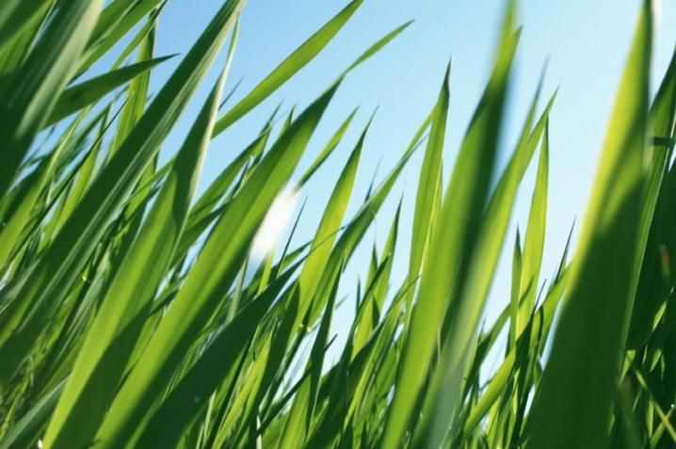
Grass

Slide 5
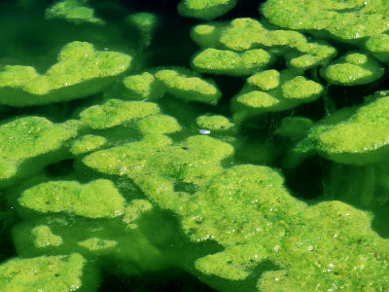
Algae

Slide 6
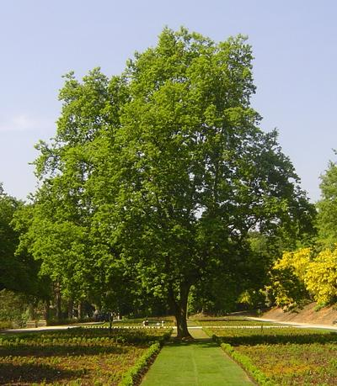
Oak tree

Slide 7
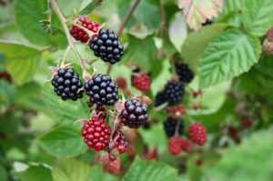
Blackberry bush

Slide 8
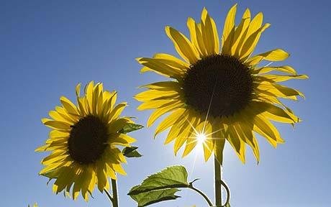
Sunflower

Slide 9
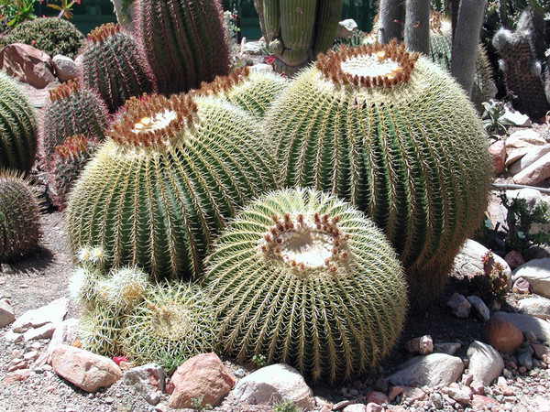
Cactus

Slide 10
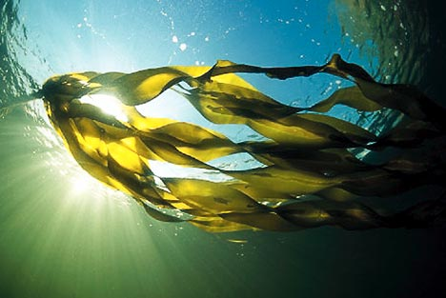
Seaweed

Slide 11
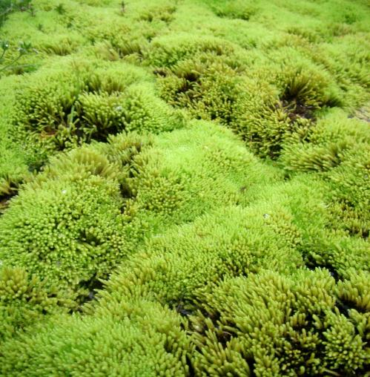
Moss

