Slide 1
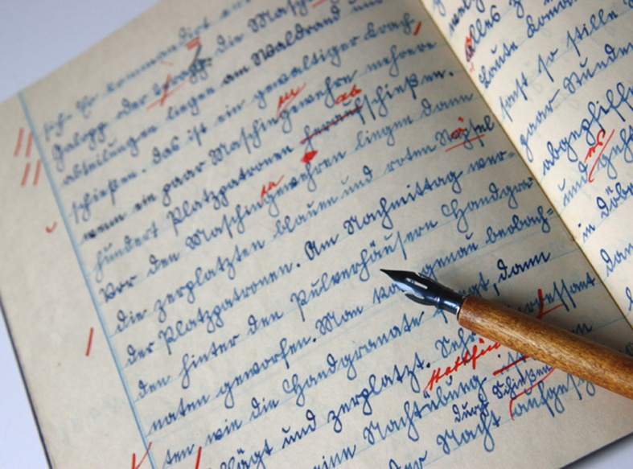
Why is handwriting important?

Slide 2
A brief history of writing
The Egyptians used hieroglyphics over 4,600 years ago
By 800BC (about 2800 years ago) the ancient Greeks had adopted
a Phoenician alphabet
22 phonetically-based symbols

Slide 3
In 146 BC the Roman Empire conquered Greece.
The Romans adopted the 23 letter Greek alphabet.
This alphabet spread across Europe and to England.

Slide 4
In the 10th Century the letter u was created
In the 12th Century the letter w was created
In the 15th Century the letter j was created
u
w
j
This brought the alphabet to 26 letters
A b c d e f g h I j k l m n o p q r s t u v w x y z

Slide 5

Now we have computers, why worry about handwriting?

Slide 6



When might you need to write?
(Rather than type, use a computer or send a text)
Taking notes at school or college
Exams
Shopping lists
Filling out forms
Birthday Cards or Love letters !
During a power cut

Slide 7
Your handwriting – 3 key points
1. Legible
2. Speed
3. Comfortable

Slide 8
Neat or Quick?
Neat
Sometimes you need neat handwriting
Best work for folders
Letters
Birthday cards
This may take longer
Quick
Sometimes you need to write quickly
Exams
Notes in lessons
Story plans or drafts

Slide 9

Remember your handwriting is unique to you.
It is part of your personality
Make it your own

