Slide 1
World War II (1939-1945)

Slide 2
What’s Essential?
Causes of the War (underlying and direct)
Reasons for American Neutrality (various acts/events)
Reason for American entrance: Pearl Harbor
Wartime goals of the Allies
Major battles: D-Day, Iwo Jima, Okinawa

Slide 3
Essential to Know (con’t)
American Homefront (women, blacks, Japanese internment)
Yalta and Potsdam Conferences and their significance
Decision to drop atomic bomb and its lasting effects

Slide 4
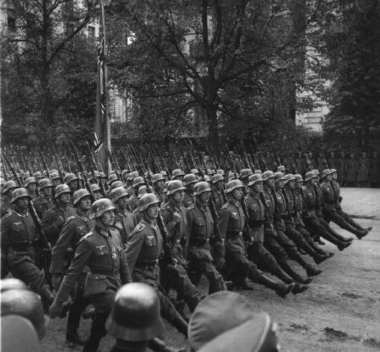
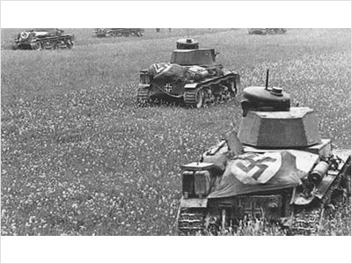
Causes for World War II
UNDERLYING:
Treaty of Versailles
Nationalism
Worldwide Depression
Dictatorships
The policy of appeasement
American Isolationism
DIRECT:
Germany invading Poland on September 1st, 1939

Slide 5
The Axis Powers!!!

Slide 6
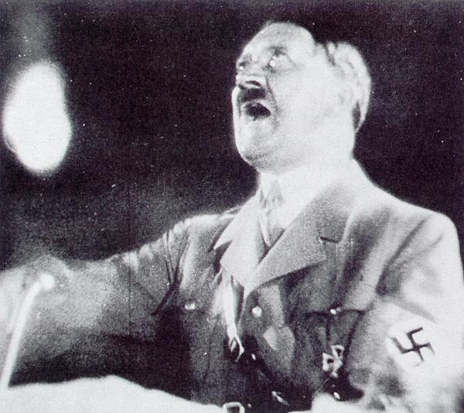

Hitler and Nazi Germany
Rise to power result of weakness of previous government (1933- became Chancellor)
Charismatic speaker, preached German nationalism, denounced Versailles Treaty
Blamed Jews, communists for Germany’s problems
Promised return of German pride

Slide 7


Benito Mussolini in Italy
Fascist leader who took control of Italy in 1922
Wanted to create another Roman Empire
Invaded Ethiopia in 1935
Along with Hitler supported Francisco Franco in the Spanish Civil War (combat experience)

Slide 8
Japanese Expansion
Sought total control of Pacific (resources)
1931- military occupation of Manchuria
1936- Japan signs Pact with Germany, Italy
Nanking Massacre- December 1937

Slide 9
American Neutrality
Domestic: U.S. in midst of Great Depression, public intent on remaining neutral
1935: First Neutrality Act (no sale of arms to belligerent nations)
1937: Arm sales only on “cash and carry” basis
FDR warns of impending problems
President Roosevelt

Slide 10
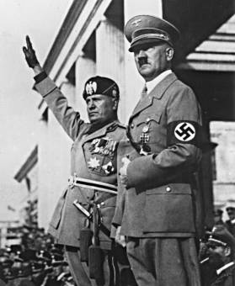
Isolationism in the United States
Economic, military reasons for neutrality
Tried to prevent mistakes that led to WWI involvement
FDR: “Let no one imagine that we will escape…that this western hemisphere will not be attacked”—outraged many isolationists
Hitler and Mussolini

Slide 11
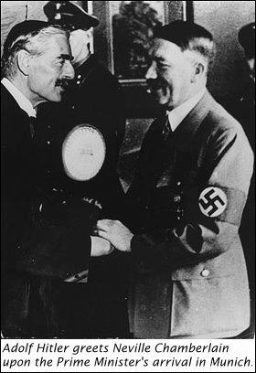
Appeasement
1938- Hitler invades Austria, Sudetenland on Czech border
Munich Conference (1938): Chamberlain and Daladier allow Hitler to do this (appeasement)
Chamberlain: “Peace in our time”
British rearmament

Slide 12
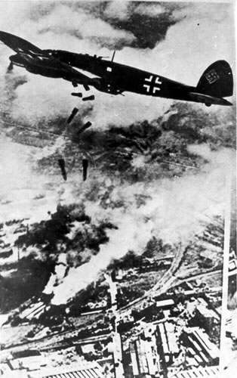
War Erupts!!!
March 1939- Hitler breaks Munich agreement, invades rest of Czechoslovakia
August 1939- Hitler signs nonaggression pact with rival USSR, turns attention west
September 1, 1939- “blitzkrieg” invasion of Poland; Britain and France declare war on Germany
German “blitz” of Warsaw

Slide 13
World War II (1939-1941)
Hitler’s Wild Ride in Europe While the U.S. Watches

Slide 14
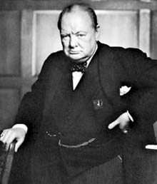
Hitler Moves in Europe
April 1940- Hitler seizes Norway, Denmark
May- Netherlands, Belgium, Luxembourg
By June, Hitler controls France, turns attention to Britain
Fall 1940- Battle of Britain
London heavily bombed but Churchill remains defiant
British Prime Minister Winston Churchill

Slide 15
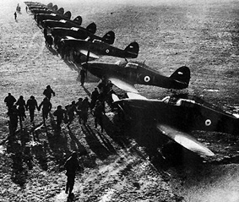
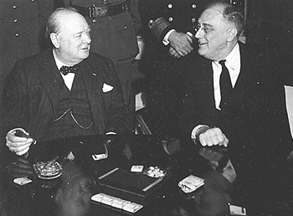
The United States and Britain
1939- Roosevelt revises Neutrality Act, allows for arms trade
Public opinion divided
Election of 1940- FDR wins 3rd term
1940: Destroyers for Bases Deal
1941: Lend-Lease Act

Slide 16
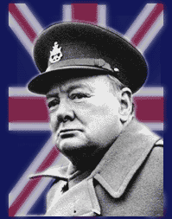
“Destroyers for Bases”: called for 50 American destroyers to be exchanged for the use of 8 British naval bases along the North Atlantic coast
“Lend-lease”: made it possible to lend or lease supplies to any country whose interests were vital (GB)- $50 billion

Slide 17

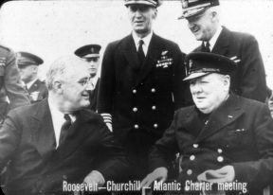
The U.S. Enters the War
The “destroyers for bases” deal allowed the U.S. to extend its influence
August 1941- Atlantic Charter: Churchill and FDR agree to defend democracy, free trade and economic advancement
The U.S. destroyer Greer attacked in September 1941
US directly involved in naval warfare
USS Greer
Atlantic Charter

Slide 18
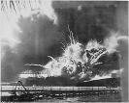
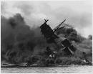
United States and Japan
Japan wanted to extend influence in Far East
July 1940: U.S. embargo of raw materials to Japan
1941: Lend-Lease aid to China
Anticipating attack in the Philippines
December 7, 1941: Japan attacks Pearl Harbor, Hawaii
Japanese attack on Pearl Harbor

Slide 19
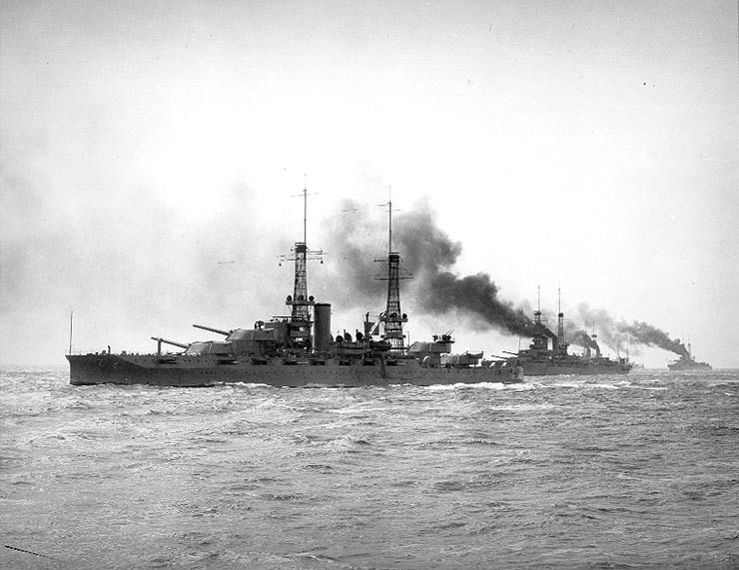
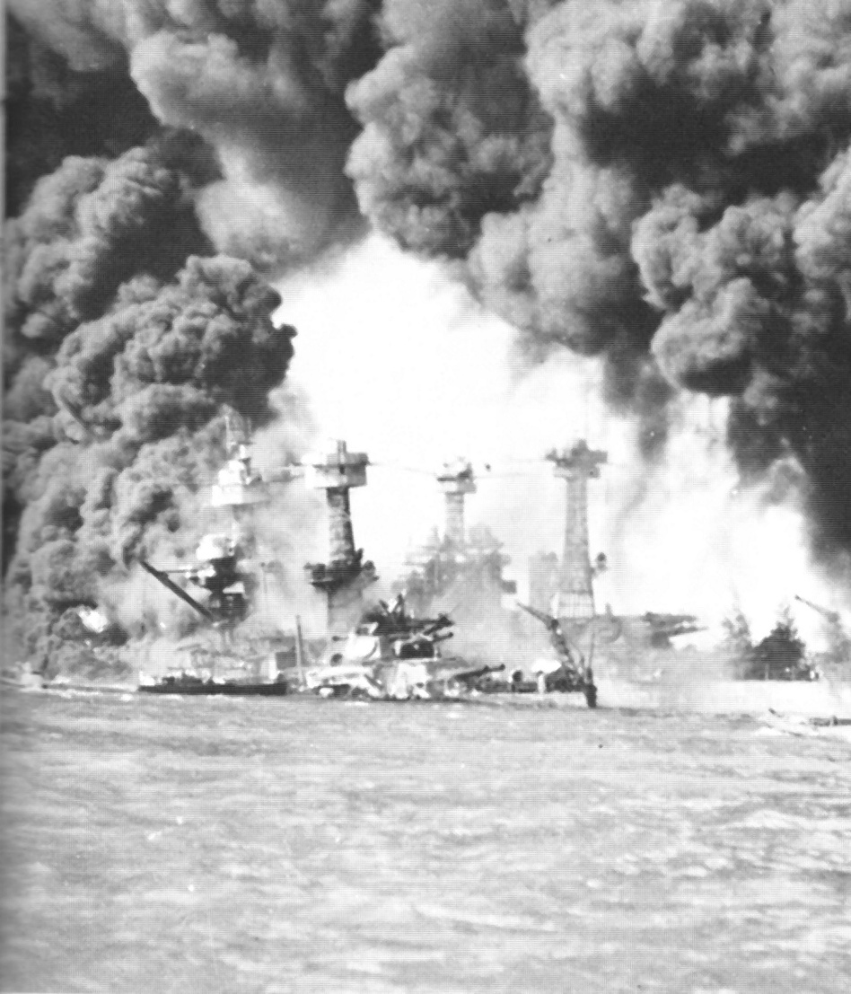
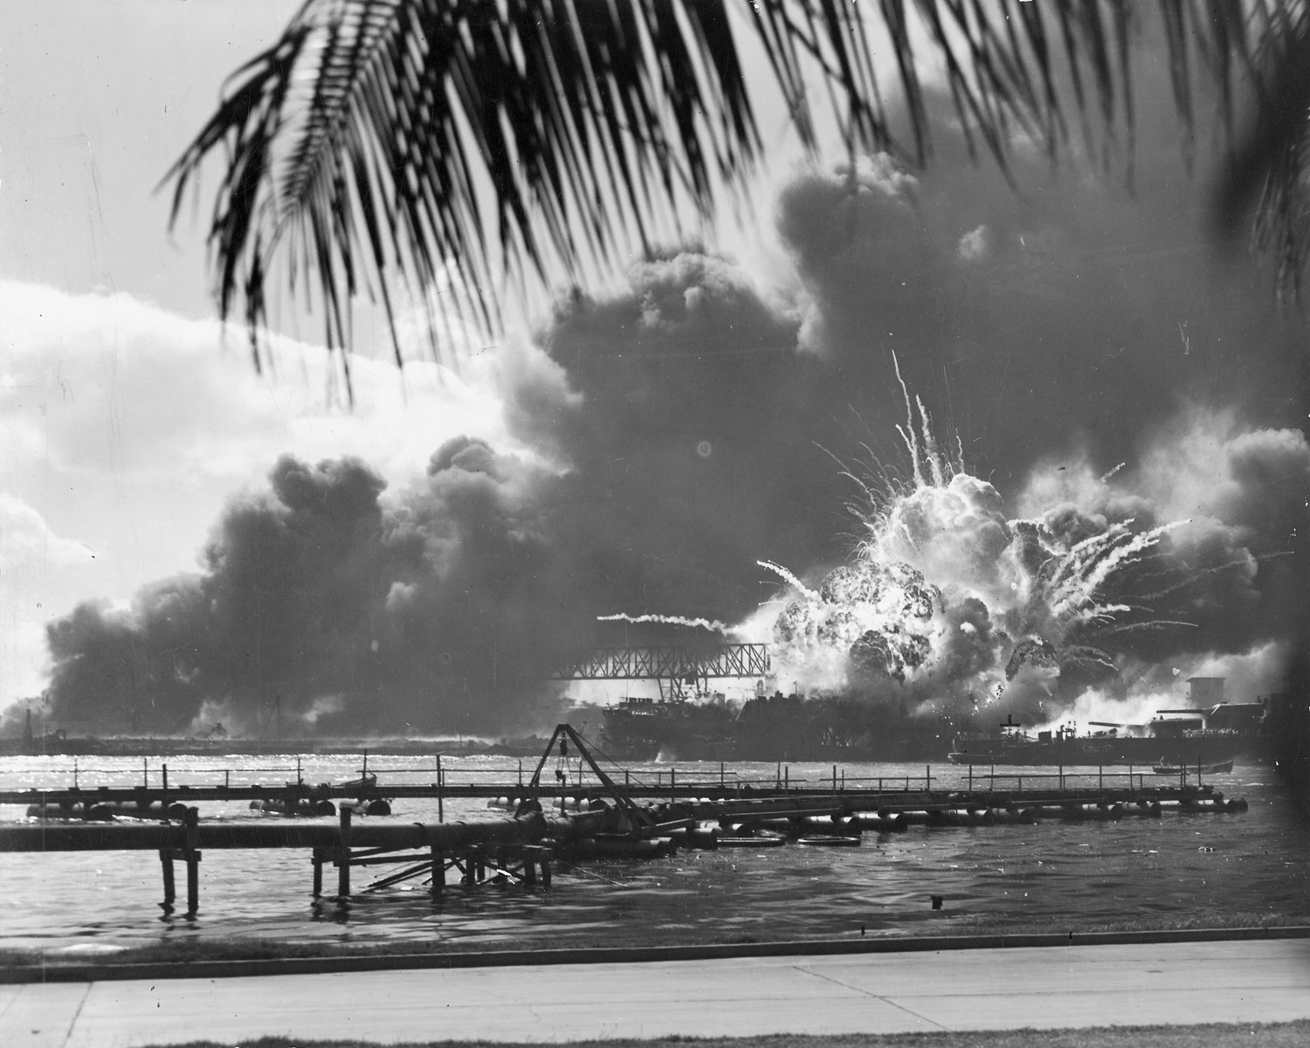
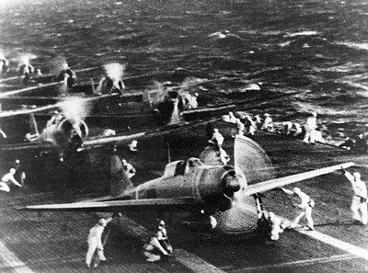
Images of Pearl Harbor

Slide 20
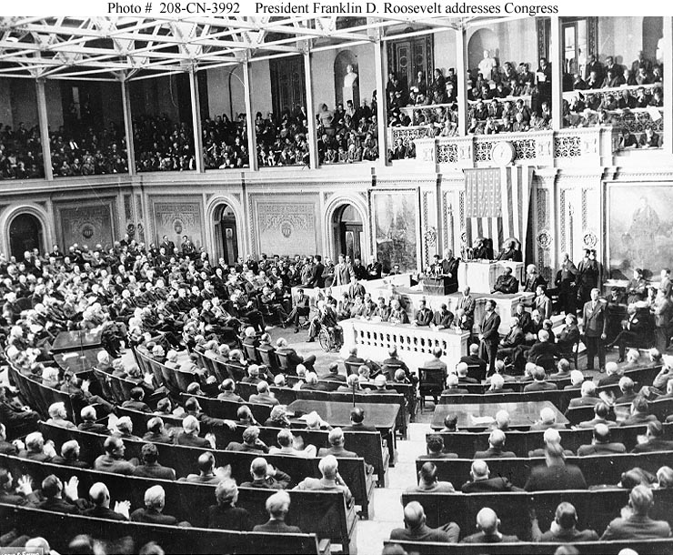
America Enters War
Pearl Harbor attack devastates nation
FDR: “A date which will live in infamy”
December 8, 1941- FDR receives war declaration from Congress against Japan
Germany, Italy declare war on United States
FDR addresses Congress after Pearl Harbor attack

Slide 21
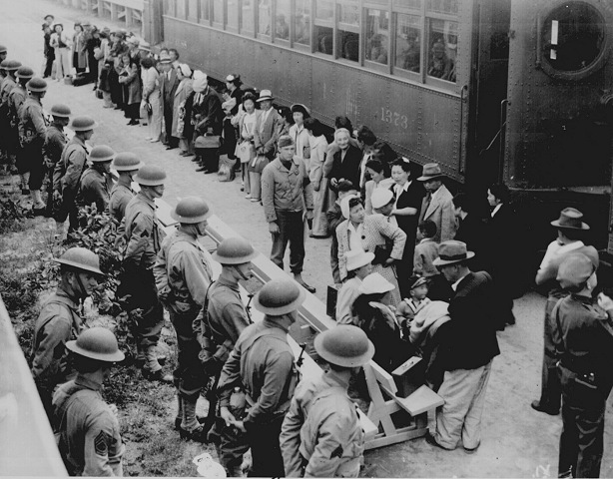

Japanese Internment
February, 1942: FDR issues Executive Order
Over 100,000 Japanese-Americans on West Coast moved to the interior
Japanese farms/businesses bought for far less value

Slide 22
Allied Military Strategy (1941-1945)

Slide 23
The Participants
Allied Powers
  -England
  -Soviet Union (after German attack on June 22, 1941)
  -France
  -United States
Axis Powers
-Italy
-Germany
-Japan

Slide 24
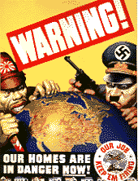
Mobilizing for War
1940- Economy focuses on military mobilization
Massive industrial output (twice as productive as Germany, 5 times Japan)
Primary focus: tanks, planes, battleships
War Production Board
Military draft, training
Wartime propaganda

Slide 25
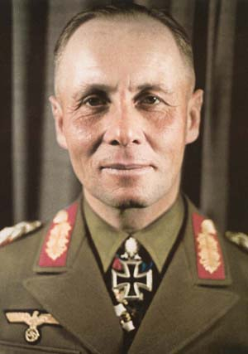
The Liberation of Europe
FDR: Liberate Europe first and pursue an “active defense” in the Pacific
Battle of Atlantic: Hitler’s “Wolf Packs” vs. Allied Navies
Clear Germany from North Africa
Late 1942: Only Tunisia was controlled by Axis Powers
Erwin Rommel, the “Desert Fox”

Slide 26
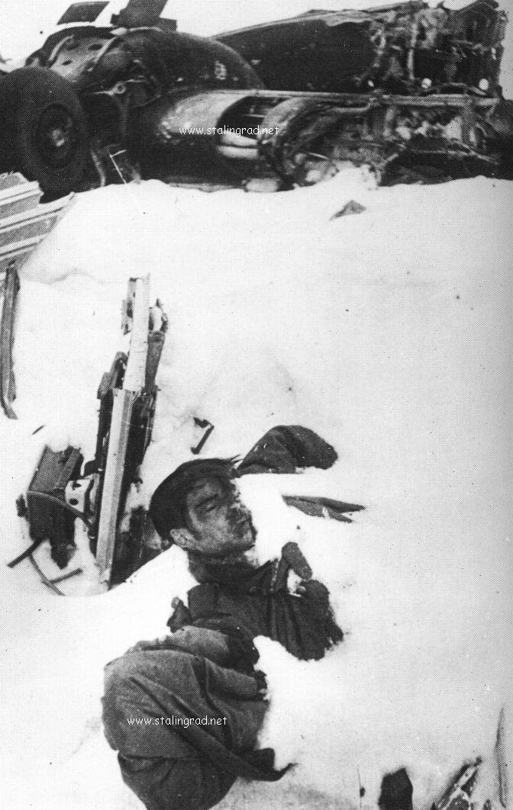
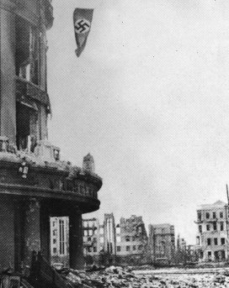
Allied Advances in Europe (1943-1944)
January, 1943: Allies agree to fight until they win “unconditional surrender”
February 1943: SU takes back Stalingrad and moves westward
Same time, Allied victory in Tunisia secures Africa

Slide 27
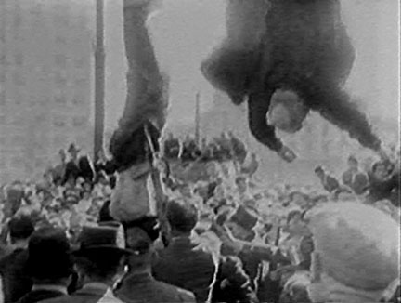
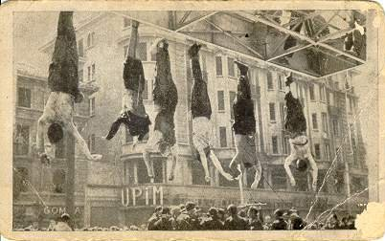
Allied Advancements Cont…
July 10, 1943: The invasion of Italy.
Fighting continues from July 1943 to June 1944 (70,000 Allied troops killed)
Separate peace was signed with new Italian government in September, 1943

Slide 28
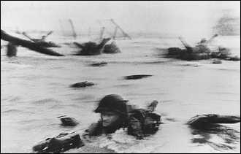
Unconditional Surrender in Europe (1944-1945)
Britain and U.S. air raid strategic sights in Germany (Flying Fortresses)
June 6, 1944: D-Day and the Allied invasion of Normandy
Battle at Normandy lasted from June 6-July 24
August 25, 1944: France liberated

Slide 29
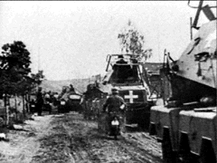
Germany’s Last Gasp Effort
Hitler was caught between Allied troops coming from the West and Stalin’s forces coming from the East.
December 1944: Battle of the Bulge
April 25, 1945: Russia and Allied Forces meet at the Elbe River
May 8, 1945: Germany surrenders (V-E DAY)

Slide 30
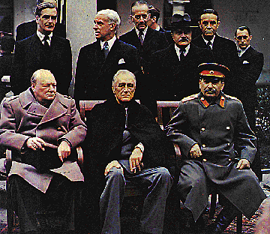
YALTA CONFERENCE (February 1945)
Plans for German surrender
Stalin agrees to hold free elections and help with Japan
Broken promises, USSR’s position strengthened
Initiated Cold War
Churchill, Roosevelt, Stalin

Slide 31
Allied Military Strategy in the Pacific (1941-1945)
By 1942, Japan had controlled almost the entire area of the Pacific
Allies were able to hold on to Hawaii and Samoa
“Active defense” campaign:
-Battle of the Coral Sea (May,1942)
-Battle of Midway (June, 1942)
-Battle of Guadalcanal (Aug. 1942-Feb. 1943)

Slide 32
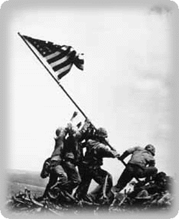
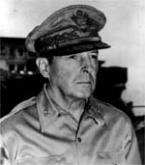
The Pacific Theatre Cont…
The Allies took control of several islands in the Pacific under the leadership of General Douglas MacArthur
-Iwo Jima (1945)
-Okinawa (1945)
The recapture of the Philippines was the highlight (Oct. 1944-March 1945)

Slide 33
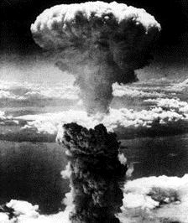
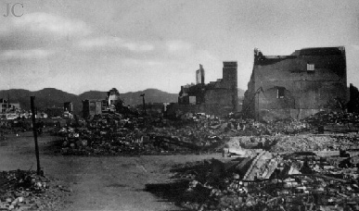
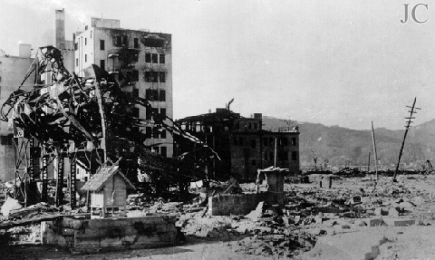
“The Alternative to Surrender is Prompt and Utter Destruction”
August 6, 1945: Atomic bomb is dropped on Hiroshima (at least 75,000 killed)
August 9, 1945: Atomic bomb is dropped on Nagasaki

Slide 34

World War II- The Homefront
American industry key to victory
Built tanks, bombs, guns, ships, ammunition, etc.
War bonds (borrowed $$$ from Americans) raised about $50 billion for war effort
Women “filling in” for men off at war
Victory Gardens
“Rosie the Riveter” inspired many women to contribute

Slide 35
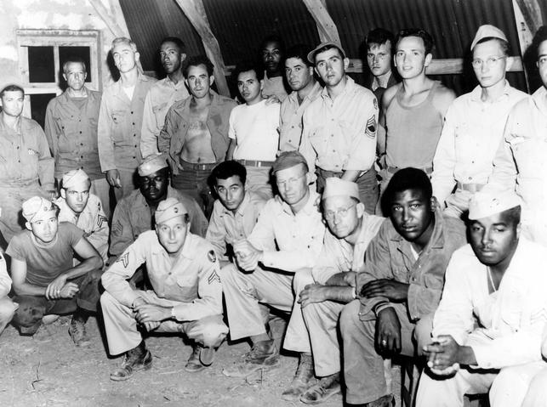
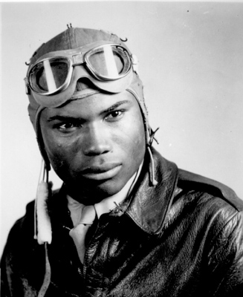
Blacks in WWII
WWII effort directly led to later civil rights movement
Patton’s “Black Panther” Battalion at Battle of the Bulge
Tuskegee Airmen
July, 1948: Truman signs Executive Order integrating US military

Slide 36
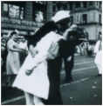
“The War is Over”
Japan surrenders to Allied Forces on the U.S. Missouri after the second bomb was dropped on Nagasaki- August 14th– V-J Day

Slide 37
THE COSTS OF THE WAR
U.S. lost over 300,000
World suffered at least 60 million
Over 25 million Russians alone died
Over 10 million in death camps
New fears arise after the war– fight to contain Communism– THE COLD WAR ERA!!

