Slide 1

Writing in Note Form
What are notes?
Why do we use note form?
Out for day. Will text later.

Slide 2
GONE TO LUNCH
BACK LATER
What words do we need?
What can we leave out?

Slide 3
POSTCARD
Hi Chris
Having GREAT time! Fed sharks from boat… Saw giant squid – 10m. Sunburn Tues. Hope your hol going well. See you - school next week!
Jamie

Slide 4
Can pictures or symbols help to speed things up?
Do we have to write whole words?
What abbreviations do you know?
Hd Gr8 tm 2day. C U l8r. X

Slide 5
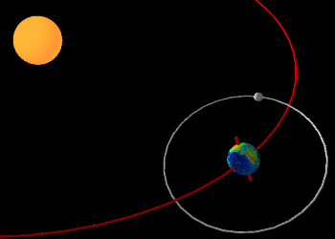
Moon – satellite – orbit Earth 28 days
Sun – large ball – burning gas
When else might we want to make our writing brief?
Earth – our planet – life – orbit Sun – 365 days – rotates – 24hrs

Slide 6
Life in ancient Egypt was centered largely on agriculture. The majority of the people were involved in farming, and the growing season lasted eight-nine months. Wheat, fruits and vegetables were the principal crops, although there was some pastoral farming of cattle, sheep, or goats. Farmers in ancient Egypt worked to reach a level of subsistence so that they could feed themselves and pay their taxes. During the annual flooding of the Nile, which typically lasted from July through November, farming was impossible. But when the waters receded, a thick layer of fertile silt over the farmlands remained to insure rich soil for their crops and thick grasses for their grazing animals.
How can we make notes from larger pieces of text?

Slide 7
Life in ancient Egypt was centered largely on agriculture. The majority of the people were involved in farming, and the growing season lasted eight-nine months. Wheat, fruits and vegetables were the principal crops, although there was some pastoral farming of cattle, sheep, or goats. Farmers in ancient Egypt worked to reach a level of subsistence so that they could feed themselves and pay their taxes. During the annual flooding of the Nile, which typically lasted from July through November, farming was impossible. But when the waters receded, a thick layer of fertile silt over the farmlands remained to ensure rich soil for their crops and thick grasses for their grazing animals.
Mainly agriculture - growing season - eight-nine months – wheat fruits vegetables - some cattle sheep goats - feed themselves - pay taxes - annual flooding – Nile - July to November - farming impossible – when waters receded – left layer fertile silt - crops - thick grasses for grazing animals.

Slide 8
North Africa
5000 yrs ago
pottery
statues
Where/when?
Artefacts
What other ways are there to make notes about things and for planning to write?
papyrus
Ancient Egypt
Gods/afterlife
burials
Everyday life
Mummies
Tombs
J Nickels 2007

